Slide 1



Eclipse SDV Hackathon Chapter 4
OTA Outlaws: Safety Evidence Factory
Doctor Whodunit · Every fault leaves evidence
October 6-8 2026
COPYRIGHT (C) 2026, ECLIPSE FOUNDATION
Notes:
Hi, we are the OTA Outlaws. In the Doctor Whodunit challenge we built a Safety Evidence Factory: it injects faults into a safety function and proves - automatically and traceably - that the fault was caught.

Slide 2




The Problem: A Stuck Sensor Silently Disarms the Warning
Cell temperature
Safety monitor
Occupants
≥ 5 min
UN R100.03 / GTR 20: occupants must be warned before a thermal event in the battery becomes hazardous
42 · 42 · 42 °C
(signal stuck)
“Looks stable –
all clear”
No warning while
the battery heats up
Stale, stuck or implausible sensor data can make a safety monitor report “all clear” while the battery overheats.
Every OTA
UN R156: each software update needs a managed, documented process – mandatory for new EU vehicles since 07/2024
Proving that monitors catch these faults is manual today, tied to HIL labs – and has to be repeated for every software release.
07/2026
China GB 38031-2025: “no fire, no explosion” for EV traction batteries
How do you prove – on every OTA release – that the warning still works?
Copyright© Eclipse Foundation AISBL and contributors. Made available under CC-BY-SA 4.0 International.
Notes:
If a cell-temperature signal freezes, the safety monitor sees a stable value and stays silent - exactly when it should warn. Regulation is tightening: UN R100 requires an early occupant warning, UN R156 requires a controlled process for every software update, and China's GB 38031-2025 demands no fire and no explosion from July 2026. Today, proving that monitors still work is manual lab work, repeated per release.

Slide 3



Our Solution: A Portable Safety Evidence Factory
Hazard
Safety goal
Injected fault
Detection
Mitigation
Verdict
HE-1 … HE-6 (HARA)
SG-1 … SG-4
19 scenarios
Guardian + DTC
uProtocol request
PASS · FAIL · INCONCL.
Every test verdict is linked back to the hazard it protects against – automatically.
Traceable
Portable
Repeatable
Hazard → safety goal → requirement → injected fault → DTC in OpenSOVD → verdict, for every test.
The same campaigns run in CI, in the cloud and on an in-vehicle HPC – built on KUKSA, uProtocol and OpenSOVD.
Deterministic, replayable campaigns with measured detection timing. Failures are reported, never hidden.
Copyright© Eclipse Foundation AISBL and contributors. Made available under CC-BY-SA 4.0 International.
Notes:
Our answer is a Safety Evidence Factory. It starts from the HARA: six hazardous events, four safety goals. For each requirement we inject faults, observe detection and mitigation, read the diagnostics from OpenSOVD and produce a verdict. Three properties matter: traceable, portable, repeatable.

Slide 4
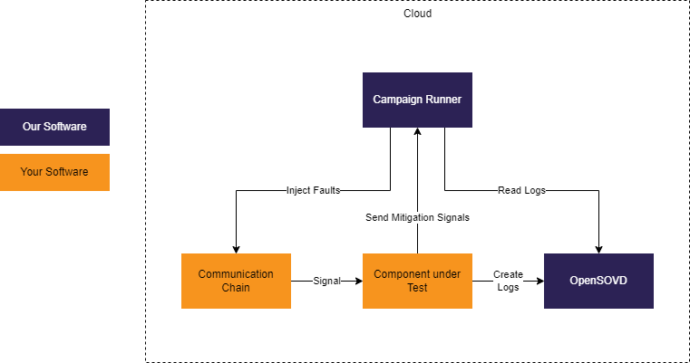
Product 1: Cloud Safety Evidence Factory
WHERE
CI pipelines and cloud runners
FOR WHOM
Software & safety teams at OEMs and Tier-1s
VALUE
Evidence on every commit and release – no lab time
Copyright© Eclipse Foundation AISBL and contributors. Made available under CC-BY-SA 4.0 International.
Notes:
Product one runs in the cloud or CI. The customer brings the communication chain and the component under test; we bring the campaign runner and the OpenSOVD-based evidence collection.

Slide 5
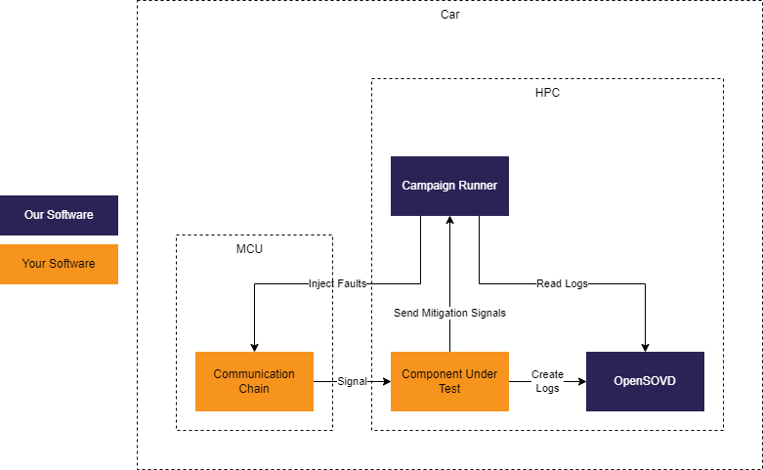
Product 2: In-Vehicle Safety Evidence Factory
WHERE
Vehicle HPC (AutoSD, Ankaios) plus sensor MCU
FOR WHOM
Validation fleets, prototypes, field operation
VALUE
Same campaigns on real hardware – evidence from the road
Copyright© Eclipse Foundation AISBL and contributors. Made available under CC-BY-SA 4.0 International.
Notes:
Product two runs the same campaign runner on the vehicle HPC, injecting faults at the MCU boundary. Same campaigns, same verdict format - now on real hardware.

Slide 6

Live Demo: Catching a Stuck Temperature Sensor
1
2
3
4
5
Baseline
Inject fault
Detect & mitigate
Diagnose
Verdict
AZ3166 sensor ECU → KUKSA → uProtocol → Guardian: nominal
Campaign runner freezes the cell temperature (temp_stuck)
Guardian raises BTG_TempSignalStuck, goes degraded, requests a driver warning
DTC with session and event ID visible in OpenSOVD
Report links the fault to FSR-2.4 → SG-2 → HE-1: PASS
Measured, not claimed: detection latency, mitigation timing and diagnostic visibility are recorded for every run (OpenSOVD visibility budget: 2 s). The Guardian dashboard shows the live state and the campaign report.
Copyright© Eclipse Foundation AISBL and contributors. Made available under CC-BY-SA 4.0 International.
Notes:
Live demo (about 90 seconds): 1) baseline from the AZ3166 board through KUKSA and uProtocol; 2) we freeze the temperature; 3) the Guardian detects the stuck signal, goes degraded and requests the warning; 4) the DTC shows up in OpenSOVD; 5) the evidence report links it all back to the hazard. Fallback if live fails: show the campaign report PDF.

Slide 7
Proof: Built and Run During the Hackathon
19
10
14 PASS
fault scenarios in one automated campaign
diagnostic trouble codes reported to OpenSOVD
14 / 19
PASS
5 FAIL
49
6 → 4
The 5 FAILs are real findings in our own Guardian (heating, timeout, out-of-range, spike, counter error) – the factory did its job. 17 of 19 scenarios carry a complete evidence chain.
automated tests in the Rust workspace
hazardous events traced to safety goals
Campaign run 7 Oct 2026, 19:28 · github.com/Eclipse-SDV-Hackathon-Chapter-Four/ota-outlaws
Copyright© Eclipse Foundation AISBL and contributors. Made available under CC-BY-SA 4.0 International.
Notes:
This is not a slideware concept. In three days we ran a 19-scenario campaign end to end. 14 scenarios pass. The five failures are genuine findings in our own Guardian - for example a late reaction to heating and to out-of-range values. That is exactly what the factory is for: it found problems we would otherwise have shipped, and it reports them instead of hiding them.

Slide 8
Why Us: From Manual Lab Work to Evidence on Every Release
Today
With OTA Outlaws
Fault injection
Manual, on scarce HIL benches
Scripted campaigns in CI, cloud and vehicle
Traceability
Spreadsheets maintained by hand
Auto-linked HE → SG → FSR → DTC → verdict
Repeatability
One-off runs, hard to reproduce
Deterministic replays, same verdict on rerun
Cost & lock-in
Proprietary licences plus lab time
Open-source core on the Eclipse SDV stack
Copyright© Eclipse Foundation AISBL and contributors. Made available under CC-BY-SA 4.0 International.
Notes:
Compared with today's practice: fault injection moves from scarce HIL benches into pipelines; traceability is generated, not hand-maintained; results are reproducible; and the core is open source on the Eclipse SDV stack, so there is no lock-in.

Slide 9
The Market: Regulation Makes Safety Evidence Mandatory
$9.1 bn
20 M+
100 %
automotive software testing market in 2025
electric cars sold in 2025 – one in four new cars
of new EU vehicles need a certified software update process
MarketsandMarkets 2025
IEA Global EV Outlook 2026
UN R156, since July 2024
BEACHHEAD
NEXT
VISION
Battery & thermal safety (BMS)
Other SDV safety monitors
Evidence-as-a-Service
ASIL-D hazards, frequent OTA updates, hard regulatory deadlines
Sensor plausibility, ADAS input monitoring, watchdogs
Any safety-relevant SDV service, verified on every release
Copyright© Eclipse Foundation AISBL and contributors. Made available under CC-BY-SA 4.0 International.
Notes:
Automotive software testing alone is a nine-billion-dollar market. More than 20 million EVs were sold last year, and every one needs battery safety evidence. UN R156 makes a controlled update process mandatory, so evidence is needed for every release. We start where the pain is sharpest - battery thermal safety - and expand to other SDV safety monitors.

Slide 10
Competition: We Connect What Others Keep Separate
Live fault injection
Safety traceability
CI / cloud native
Runs in vehicle
Open source
HIL test automation
Vector · dSPACE · tracetronic
Safety & ALM tools
Ansys medini · Polarion · Codebeamer
OTA Outlaws
Safety Evidence Factory
strong
partial
not core focus
Team assessment based on public product positioning
We complement HIL benches and ALM tools – and feed them live, traceable evidence.
Copyright© Eclipse Foundation AISBL and contributors. Made available under CC-BY-SA 4.0 International.
Notes:
HIL vendors are strong at fault injection but lab-bound and proprietary. Safety and ALM tools hold the traceability but no live test evidence. We close the gap between them - and we integrate with both rather than replacing them.

Slide 11



Real Business Cases: Who Pays and Why
OEM – OTA release gate
Tier-1 BMS supplier – safety case
Pain: Every BMS software update must be re-verified and documented before rollout (UN R156).
We deliver: Campaign runs in the release pipeline; evidence package attached to every release.
Pain: OEMs demand ISO 26262 verification evidence for every software drop.
We deliver: Traceable HE → SG → FSR → verdict reports, generated per delivery.
E-bus & e-truck fleets – field check
Assessors & technical services
Pain: Ageing sensors drift or stick; a silent monitor is a fire risk in the depot.
We deliver: In-vehicle agent runs periodic self-tests; results exposed via OpenSOVD.
Pain: Assessors must trust test reports they cannot rerun themselves.
We deliver: Replayable campaigns – any verdict can be reproduced independently.
Copyright© Eclipse Foundation AISBL and contributors. Made available under CC-BY-SA 4.0 International.
Notes:
Four concrete customers: OEMs need a release gate for OTA updates; Tier-1 BMS suppliers must deliver ISO 26262 evidence with each software drop; fleet operators want periodic health checks in the field; and assessors want evidence they can reproduce themselves.

Slide 12



Business Model: Open Core, Paid Scale
Open-Source Core
Evidence Factory Cloud
In-Vehicle Evidence Agent
Safety Engineering Services
Guardian patterns, campaign runner and contracts (EPL-2.0). Builds trust and adoption in Eclipse SDV.
Managed campaign runners, evidence archive and audit-ready reports.
Campaign runner for vehicle HPCs in validation fleets and the field.
HARA, safety concept and campaign setup for each new safety function.
Free
adoption funnel
SaaS from €2.5k
per project / month
Platform licence
+ per-vehicle fee
€40k fixed-price
onboarding
Recurring revenue from cloud and in-vehicle licences; services open the door. Prices are indicative and will be validated in pilots.
Copyright© Eclipse Foundation AISBL and contributors. Made available under CC-BY-SA 4.0 International.
Notes:
Open core: the core stays open source to drive adoption in the Eclipse SDV ecosystem. We earn money with the managed cloud factory, the in-vehicle agent licence, and safety engineering services that onboard each new safety function.

Slide 13
Business Case: One Safety Function, One Year
Assumptions per safety function
12
OTA releases per year
8 + 3
engineer days + HIL bench days per release (manual)
€1,000
per engineer day · €800 per HIL bench day
1
review day per release with the factory
−66 %
cost from year 2 · payback ≈ 6 months · evidence on every release instead of samples
€2.5k
cloud per month · €40k one-time onboarding
Illustrative – to be validated with pilot customers. One vehicle platform has dozens of such safety monitors.
Copyright© Eclipse Foundation AISBL and contributors. Made available under CC-BY-SA 4.0 International.
Notes:
A conservative example for one safety function: 12 OTA releases a year, each needing about 8 engineer days plus 3 HIL days of manual regression - roughly 125k euros per year. With the factory: one review day per release plus the cloud subscription - 42k euros from year two, 82k in year one including onboarding. That is two thirds less cost, a payback of about six months, and full evidence on every release. A real platform has dozens of such monitors.

Slide 14
Roadmap and Funding Ask
Q4 2026 – Q1 2027
Q2 – Q3 2027
Q4 2027 – 2028
1 · Harden
2 · Pilot
3 · Scale
Remote reruns via openDuT
Ankaios / AutoSD orchestration
Durable DFM storage, fix open findings
2 paid pilots: OEM + Tier-1
Publish as SDV Blueprint
First managed cloud runners
ISO 26262 tool qualification
SaaS general availability
Beyond BMS: ADAS monitors
Ask: €1.2 M seed
60 %
15 %
15 %
10 %
18 months runway to two paying pilots and a qualified tool chain
€720k Engineering team (5 FTE)
€180k Tool qualification & certification
€180k Pilots & go-to-market
€120k Cloud infrastructure & hardware
Copyright© Eclipse Foundation AISBL and contributors. Made available under CC-BY-SA 4.0 International.
Notes:
Next steps: harden the prototype - remote reruns, Ankaios orchestration, durable diagnostics. Then two paid pilots with an OEM and a Tier-1, and finally tool qualification and SaaS launch. We ask for 1.2 million euros seed for 18 months, 60 percent of it for the engineering team.

Slide 15

Team and Contact
J
Jens
S
Sopan
Y
Youssef
Project lead, requirements & safety engineering
CAN & ThreadX sensor ECU (AZ3166)
KUKSA CAN Provider & Data Broker
A
Anukul
J
Jannis
J
Julian
OpenSOVD, AutoSD, openDuT
Battery Thermal Guardian
uProtocol, watchdog & dashboard
github.com/Eclipse-SDV-Hackathon-Chapter-Four/ota-outlaws
Open source (EPL-2.0) · Eclipse SDV Hackathon Chapter 4, Friedrichshafen
We are looking for
Pilot partners (OEM / Tier-1), safety assessors and contributors
Copyright© Eclipse Foundation AISBL and contributors. Made available under CC-BY-SA 4.0 International.
Notes:
Six people, one evidence chain - from the sensor ECU to the safety case. Everything is open source on GitHub. We are looking for pilot partners, assessors and contributors.

Slide 16
Thank you!
Questions?
Every fault leaves evidence.
October 6-8 2026
COPYRIGHT (C) 2026, ECLIPSE FOUNDATION
Notes:
Thank you - happy to take questions.

